Slide 1
Concept of Hyper-Visor
A hypervisor is a system software that acts as an intermediary between computer hardware and virtual machines.
The hypervisor allocates the resources to VM’s.
Known as virtual machine manager.

Slide 2
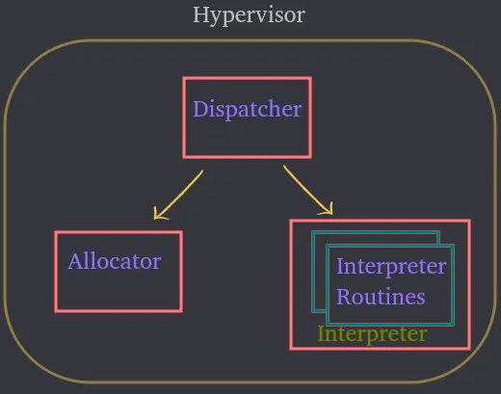
Modules of HV:

Slide 3
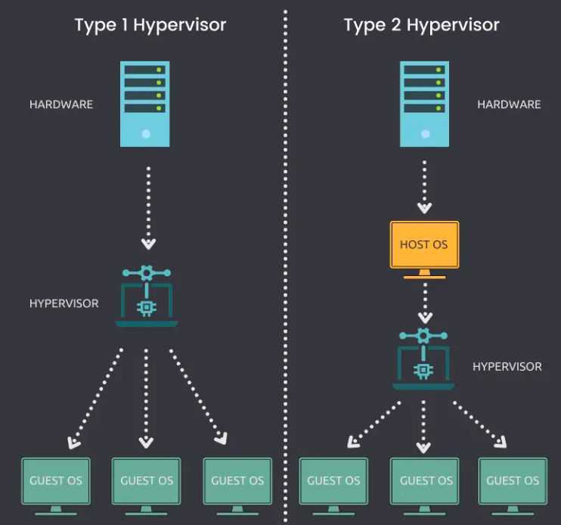

Slide 4
Types of Hypervisors
Two types:
Type 1 : bare metal hypervisor
: Installed and Directly runs on physical host.
: Direct access to resources.
: Eg :VMware ESXi, Citrix Hypervisor and Microsoft Hyper-V
Type 2 : hosted or embedded hypervisor
: Installed and requires an OS to run on a physical host.
: Indirect access to resources .
: Eg : VMware Workstation Player, VMware Workstation Pro and VirtualBox

Slide 5
Hypervisors vs containers
Hypervisors are used to create and run virtual machines (VMs), which each have their own complete operating systems, securely isolated from the others.
whereas
Containers package up just an app and its related services. This makes them more lightweight and portable than VMs, so they are often used for fast and flexible application development and movement.

Slide 6
